Slide 1

Search Ranking and Personalization at Airbnb
Mihajlo GRBOVIC
Search RANKING TEAM

Slide 2
Airbnb
Worldwide Accommodations Leader
4M listings in 190 Countries
2M guest stay at Airbnb every night
2-sided Marketplace:
Hosts: looking to rent their space
Guests: looking for a place to stay
Our job:
Connect guests with hosts

Slide 3
Search At Airbnb
query:
location, dates, guests, map, filters
results:
results:

Slide 4
Search At Airbnb
Search Components
Retrieval of Listings
Ranking of Listings
Location Queries (e.g. New York): Rule based: fetch everything near by
Broad Queries (e.g. Skiing in France): Model based
Model based: query, user and listing features
Trained using user actions: clicks, wishlists, inquires, bookings and rejections
Tradeoffs Guest and Host preferences

Slide 5
Typical Guest Flow
Instant Book
Guest actions
Host actions
One listing can accept only one guest for a certain set of dates

Slide 6
Guest Sessions
Average user does dozens of searches over multiple days before they book
Booked ☺

Slide 7
Model v0:
Last Search (label propagation) + Utility Prediction

Slide 8
Model v0:
Last Search + Utility Prediction
f(x)-> y
Display Results in Descending Order of Predicted Utility
Regression:
Features (X) :
Model (f) : GBM model
Listing Features (engagement, quality, type, capacity, etc.)
Query Features (destination, nights, guests, etc.)
Guest Features (origin, past bookings, listing preferences, short term history)
Rejection Probability: output of separate model that predicts Host rejections

Slide 9
How we iterate?
f(x)-> y
change prediction model (GBM, TF)
change Loss function
change how we create training data
add new features
change what we predict

Slide 10
Examples of Successful Iterations
Significant Booking Gains
Instead of only Last Search use Earlier Searches as well
Propagate labels back
Early Attribution

Slide 11
Examples of Successful Iterations
Pointwise to Pairwise
Weighted Pairwise (LambdaRank)
Dual Discount Curve Pairwise (Modified LambdaRank)
Weight Top Positions More in Pairwise Loss
Lambda Rank focus only on pushing good outcomes to the top
But its equally important to push bad outcomes to the bottom

Slide 12
Examples of Successful Iterations
Real-time Personalization
Main Challenges
Guests do not visit every day (most travel up to 2-3 times a year)
Preferences may change from visit to visit
Rarely go to same location twice
Approach: In-session personalization
Memorize listings you clicked on recently
Show similar listings to the one you liked (wishlisted, long clicked, contacted)

Slide 13
Real-time Personalization using Embeddings
recently long-clicked listings by user (>60 sec)
Embedding Features:
1. longViewEmbeddingScore
2. wishlistEmbeddingScore
3. contactEmbeddingScore

Slide 14
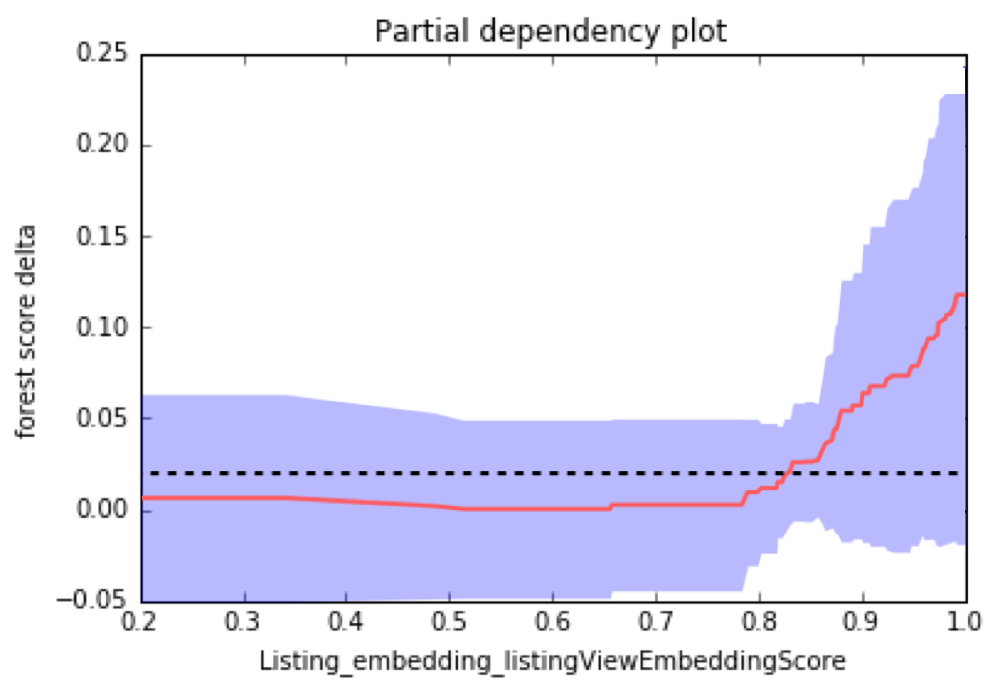
Real-time Personalization using Embeddings
Partial dependency plot
Feature Importance: top 10

Slide 15

Listing Embeddings in Search

Slide 16
Listing Embeddings
How to represent a listing?
entire home
2 guests
rome
cheap
sparse
1 | 1 | 0 | 1 | 0 | … | 0 | 1
Listing
Casa Vacanze in Rome
dense
0.9 | 2.6 | 3.1 | 0.1 | 2.2
embedding
Represent listings as numeric vectors
Vectors need to be learned using training data (search sessions)
We want listings with similar contexts to have similar vectors
Popular tool for training: word2vec

Slide 17
Search Sessions
Actions by single user (listing clicks, inquiries, bookings) ordered in time
S1
748612 4160766
S2
5473823 2582727 5473823 2582727 5473823 5473823
S3
6251934 9257649
S4
7924193 10116733 8998529 9075420 4113166
S5
5503478 4986017 5503478 5503478 5879904 4140396
S6
10237904 8680483 8718513 11691507 4831342 8004575 7866901

Slide 18
Search Sessions
We only use clicks that have >30 sec page view time (no accidental clicks)
10237904 8680483 24675234 8718513 11691507
45sec
54sec
4sec
82sec
32sec
Session ends when there is more than 30 min inactivity
Session 1
Session 2
10237904 8680483 8718513 11691507 4831342 8004575 7866901
2 hours

Slide 19
Training
Example search session:
Listing8, Listing1, Listing2, Listing6
current listing
L1
RND
L6
L8 L1 L2 L6
L2
RND
L8
neighborhood
embedding space

Slide 20
Training
Skip-gram model (word2vec)

Slide 21
After Training
Can calculate similarity between any two listings

Slide 22
After Training
Can cluster listings: California

Slide 23
word2vec Modifications that Worked for us
1. Not all interactions between two listings are the same
co-click session:
5473823 2582727 5473823 2582727 5473823 5473823
co-inquiry session:
6251934 9257649
sessions that end in booking:
5473823 2582727 5473823 2582727 5473823 5473823
Positive interactions
co-click – default weight
co-inquiry – larger weight
booking sessions – larger weight

Slide 24
word2vec Modifications that Worked for us
2. Better negative sampling
Random negatives: probability of sampling a negative from same city very low (not a problem if you have 1-2 cities but we have thousands)
Random negatives from same city: leads to better within city listing similarities
Analogous to learning word vectors when data comes from many languages

Slide 25
Applications
Can Find Similar Listings

Slide 26
Applications
Similar Listings
Before
After

Slide 27
Query Embeddings in Search

Slide 28
Query Embeddings
embedding:
Query (geo_id available)
San Francisco, California, USA
0.2 | 1.1 | 7.2 | 0.8 | 3.1
embedding:
Query (geo_id not available)
Skiing France
0.7 | 3.4 | 2.8 | 0.1 | 2.2
Represent queries as numeric vectors
Vectors need to be learned using training data (search sessions)
We want queries with similar contexts to have similar vector

Slide 29
Search Sessions
Actions by single user (queries) ordered in time
Garmisch-Partenkirchen
S1
skiing_germany geo_fs2342f61IHgQ
S2
winter_wanderland winter_wonderland winter_wonderland_neitherlands skiing geo_f23432dfHf
S3
portugal_surfing portugal_surf geo_MgsRQfBOHA geo_Hw0RU41424Da
Peniche, Portugal
S4
grant_park_chicago lollapalooza grant_park_chicago geo_LIq58sDogRHf1
S5
geo_Kyvb07vZg french_quarter_mardi_gras geo_ChIJf5407f1

Slide 30
After Training
We can calculate similarities between queries
mardi_gras
geo_ChIJf5407BG
0.2 | 1.2 | 7.1 | 0.8 | 3.2
0.993
0.2 | 1.1 | 7.2 | 0.8 | 3.1
French Quarter, New Orleans, LA, United States
Application:
Autocomplete (Type-ahead)

Slide 31
Before
After

Slide 32
Before
After

Slide 33
Before
After

Slide 34
Before
After

Slide 35
Questions?
Press questions:
press@airbnb.com
We are hiring ML Scientists
Contact me:
mihajlo.grbovic@airbnb.com

